Slide 1

FreshPick
Authentic groceries delivered at your door
(Group 1)

Slide 2
PROBLEM
Difficult to find and purchase international foods.
Lack of knowledge about location of stores.
Popular grocery stores like Walmart etc. do not offer wide range of international food.
Lack of proper description about international items in stores

Slide 3
SOLUTION
Doorstep delivery of international groceries
One app- variety of foods
Easy browsing and payment options

Slide 4
EVALUATION METHODS AND RESULTS
Card Sorting- Closed
Got to know categories and respective items such as Menu.
Questionnaire: Likert Scale and Surveys
Got to know preferences of users related to online shopping, international food etc.
User Testing
Found out usability problems and solutions using prototype of our app.

Slide 5
PROTOTYPE

Slide 6
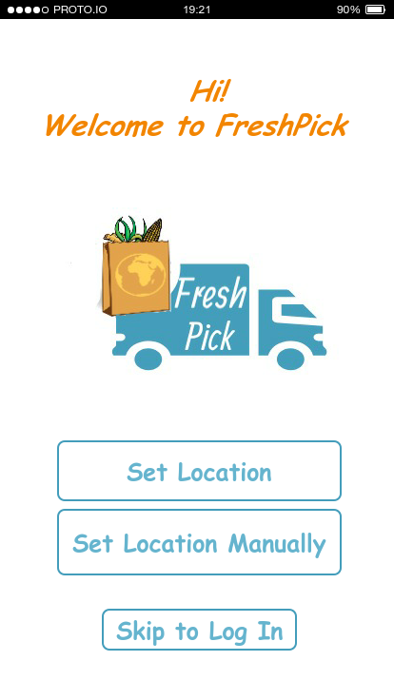
LOCATION

Slide 7
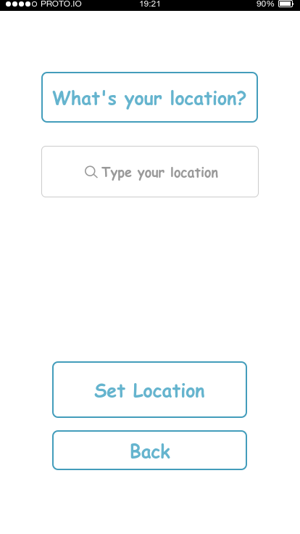
SET LOCATION

Slide 8
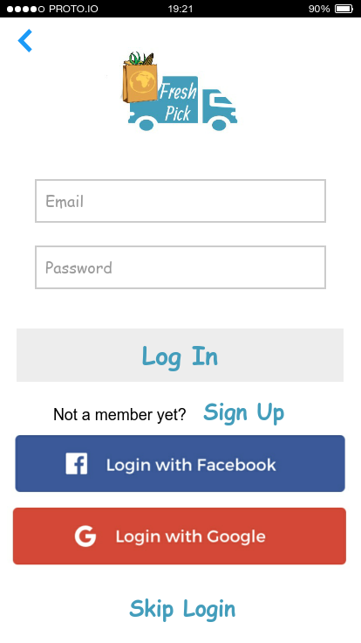
LOG IN

Slide 9
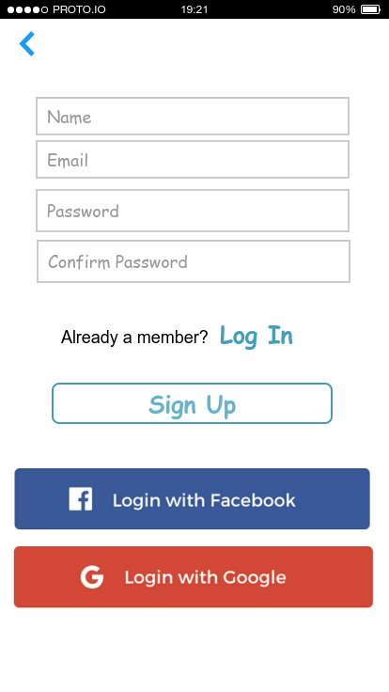
SIGN UP

Slide 10
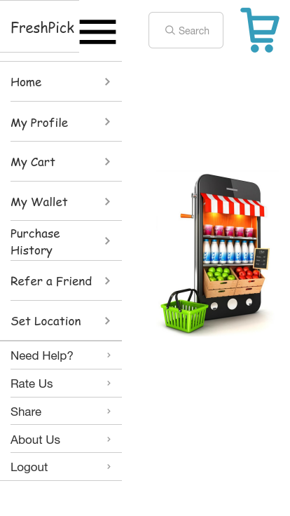
MENU

Slide 11
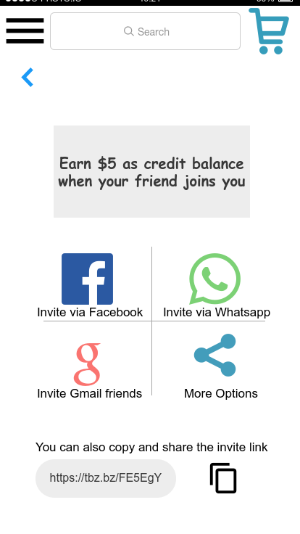
REFRRAL

Slide 12
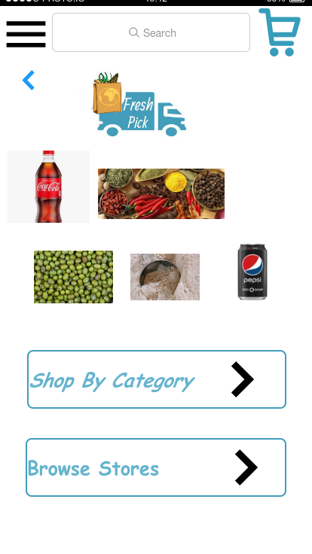
SHOP

Slide 13
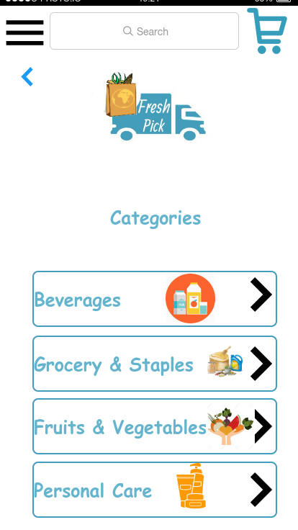
CATEGORIES

Slide 14
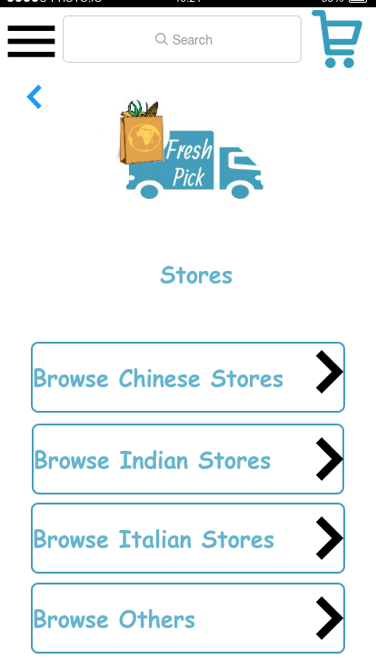
STORES

Slide 15
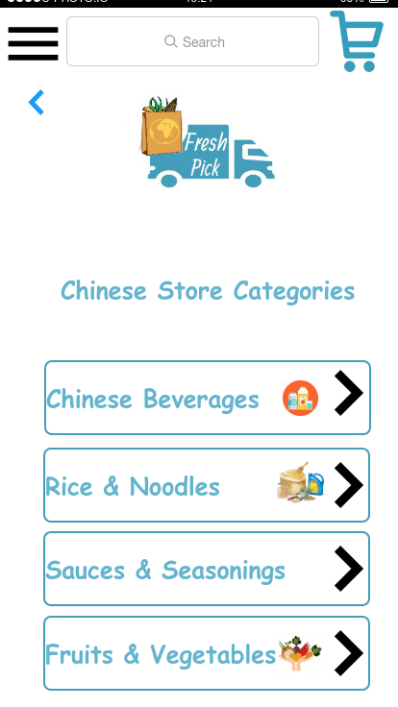
CHINESE STORE CATEGORIES

Slide 16
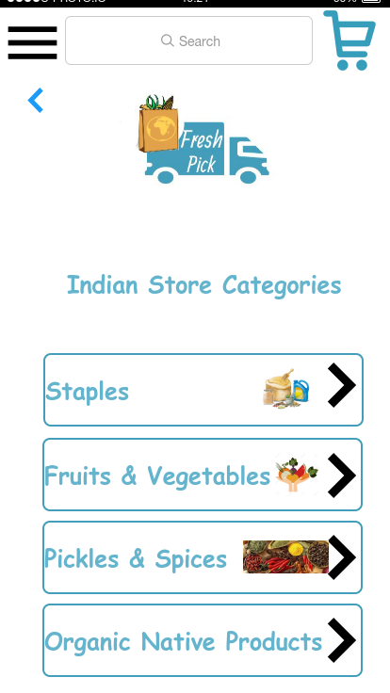
INDIAN STORE CATEGORIES

Slide 17
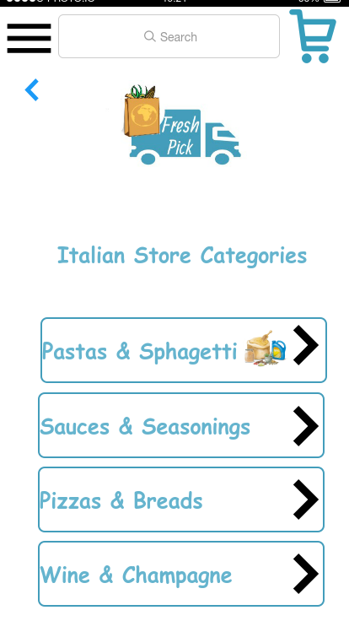
ITALIAN STORE CATEGORIES

Slide 18
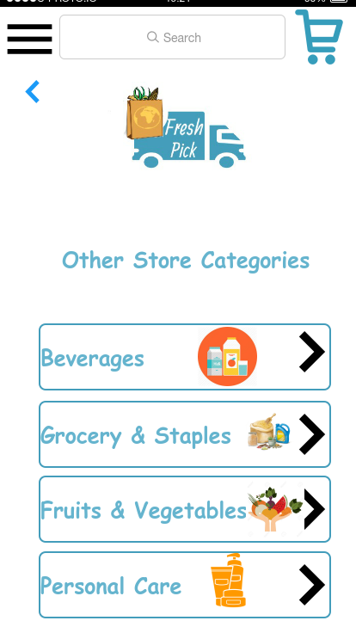
OTHER STORE CATEGORIES

Slide 19
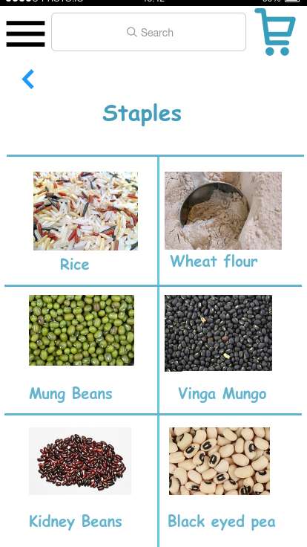
SUB CATEGORIES

Slide 20
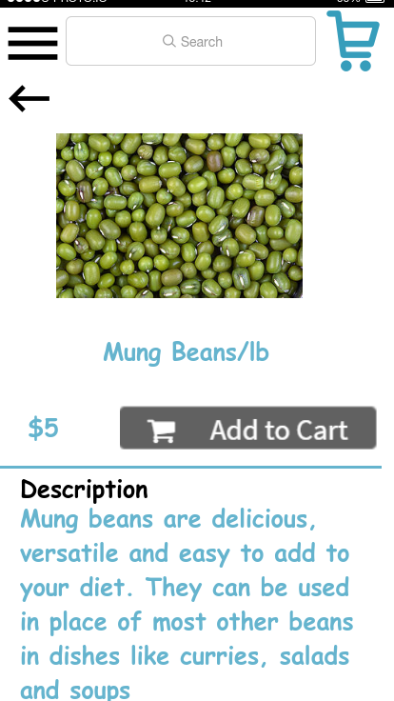
ITEM DESCRIPTION

Slide 21
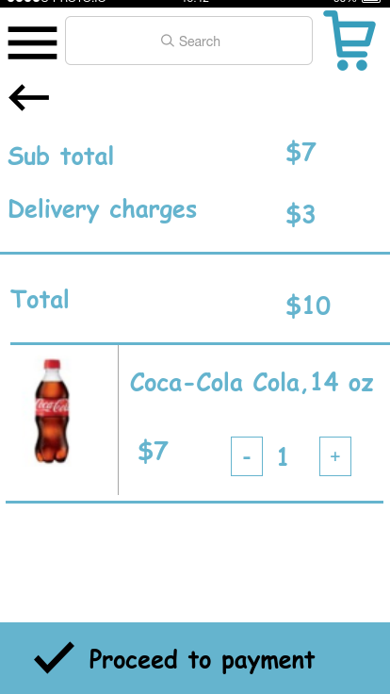
CART

Slide 22
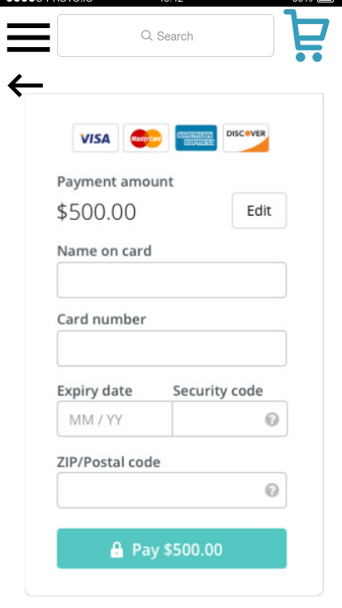
PAYMENT

Slide 23
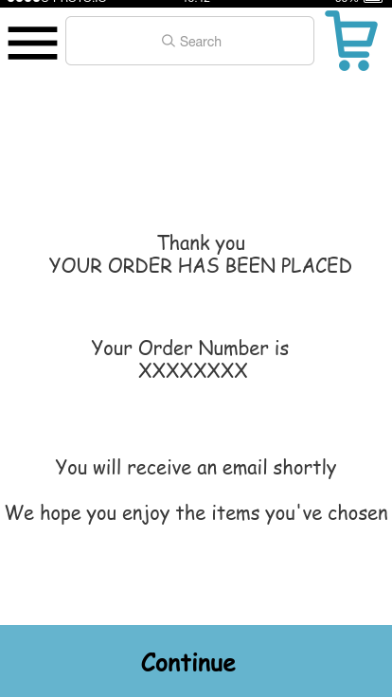
ORDER CONFIRMATION

Slide 24
LIVE APP WALKTHROUGH
https://saiadarshbabukuruvella.proto.io/player/index.cfm?id=16cadead-63ac-4945-b55c-8c0b1e676efc

Slide 25
CONCLUSION
Targeted customers looking for international and native food items.
Developed a common platform for purchasing a wide range of international foods.
Doorstep delivery of these products.
Easy to use app - user friendly browse and payment methods.

Slide 26
FUTURE WORK
Developing and Publishing the app in official market.
Adding recommendations and reviews for products.
Another app for shopkeepers to upload their products.
Collaborate with popular taxi services for delivery of products.

Slide 27

THANK YOU !!

